Slide 1
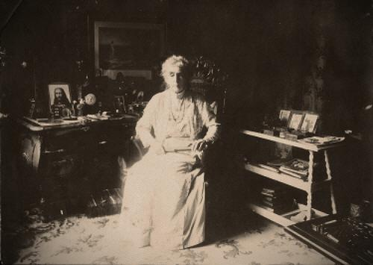
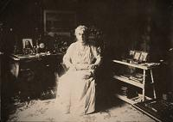
Graphical interpretation
of symbolism in
ADELMA VON VAY´S BOOK
“SPIRIT, POWER AND MATTER”
by
Joma Sipe

Slide 2
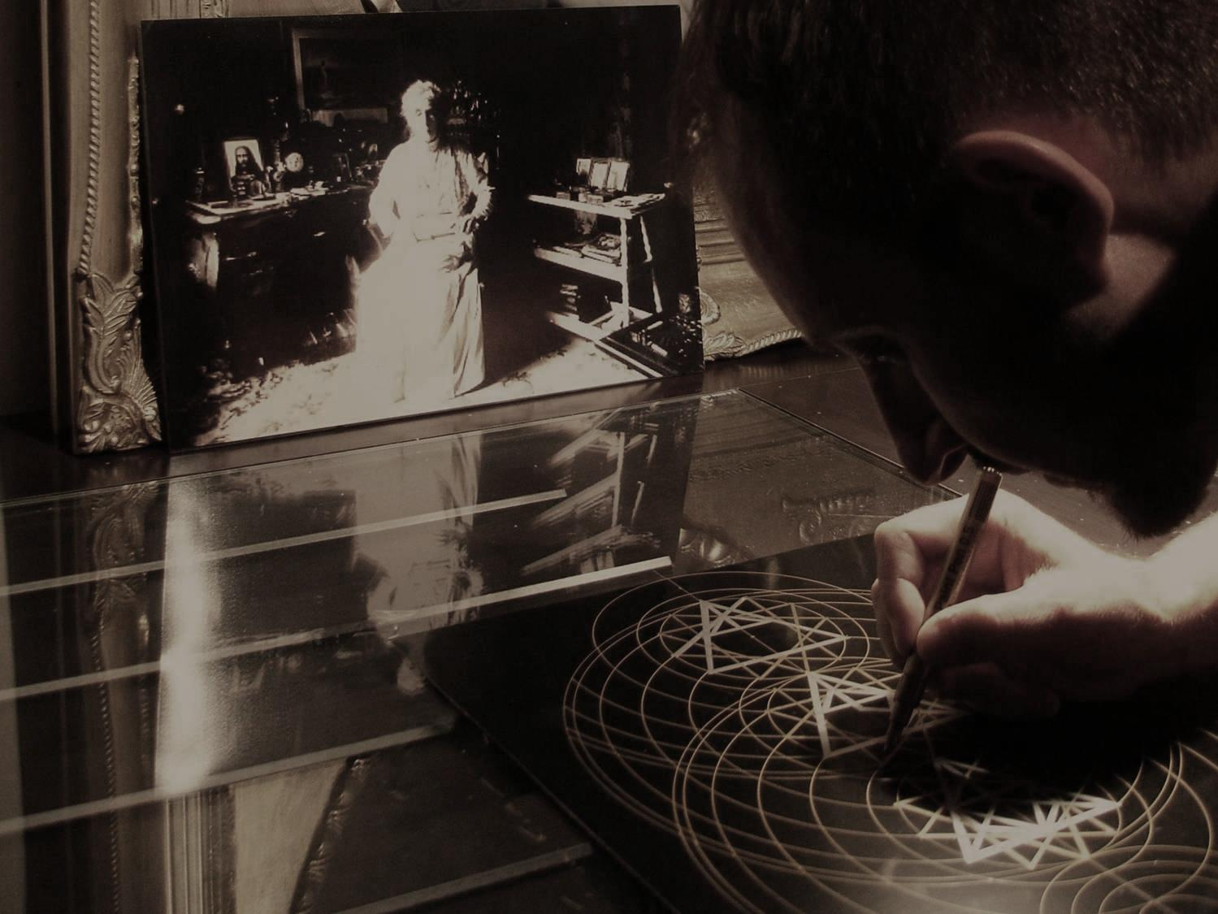
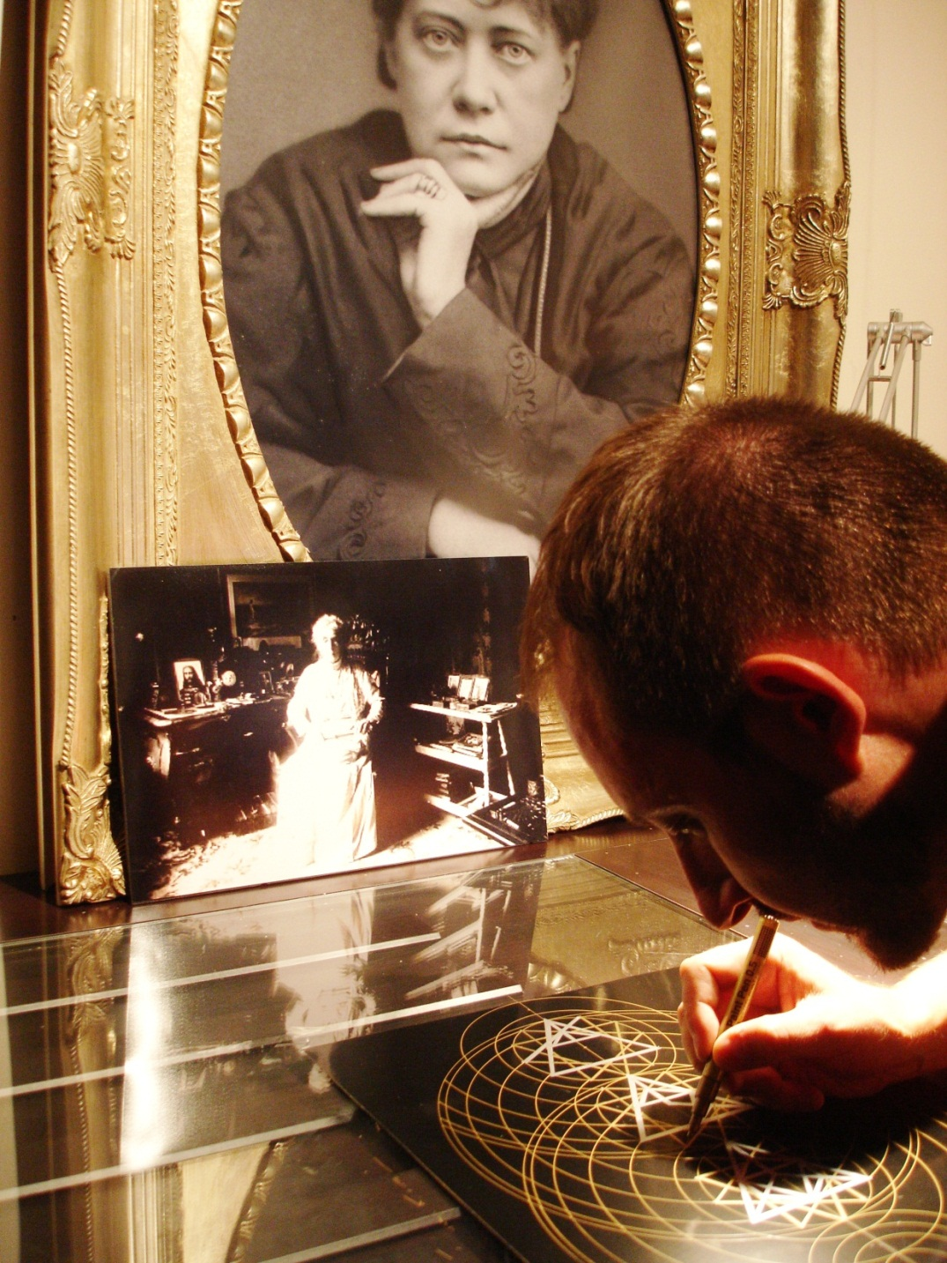
JOMA SIPE
was born in the city of Porto, Portugal, on the 2nd August 1974.
He spent almost all his childhood in the City of Vila Nova de Gaia, near Porto, where he still lives and have his how studio. He started painting ordinary motifs as landscapes and faces, using oils and acrylics with exuberant colors. Soon he realized this was not the way that he wanted to use to express his inner spiritual feelings, the desired goal that was for long time creating inside. Since very earlier, 13-15 years of age, he started feeling an inner inquietation to discover the reasons for living in this planet and trying to answer the common phrases as “Where do we came from?”, “What are we doing here?”, “To where shall we go?”…
These inner questions took him to the public library where he found ancient books in Portuguese by Blavatsky and Besant. Then he soon realize a profound and inexplicable deep inner connection with Blavatsky and her teachings. He had the opportunity to read “Isis Unveiled”, “The Secret Doctrine”, “The Voice Of Silence”, among other texts by HPB. Searching among other books he learned about the inner system of Chakras, Occult Anatomy, Sacred Geometry, The Golden Number, several meditation and concentration techniques, the Ego, Alquimical Process, Kabalah, between many many other occult and esoteric subjects.
Joma Sipe webpage: www.jomasipe.no.sapo.pt
All images © Joma Sipe, 2012
It is forbidden to copy this images by any means. This material is protected by Copyright rights in Portugal and worldwide.
JOMA SIPE was born in the city of Porto, Portugal, on August 2, 1974. He spent his childhood in the city of Vila Nova de Gaia, near Porto, where he still lives and has his own studio. He started painting conventional pictures, such as landscapes and portraits, using oils and acrylics with exuberant colors. Eventually he realized that this was not the way he wanted to express his spiritual and artistic feelings. Step by step he became aware of an inner yearning. When he was between thirteen and fifteen years old, he started to feel restless, wanting to discover the reasons for living on this planet, trying to find answers to questions we all ask: “Where do we come from?” “What are we doing here?” “Where do we go after our bodies die?”
Photo: Joma Sipe working on this Series or Works in his Studio with picture of Helena Petrovna Blavatsky and Adelma von Vay.

Slide 3
These thoughtful questions sent him to the local public library in Porto, where he found books written by H. P. Blavatsky and Annie Besant, translated into Portuguese. Soon after reading those books, he felt a deep and inexplicable connection with H. P. Blavatsky and her teachings. He had the opportunity to read Isis Unveiled, The Secret Doctrine, The Voice of the Silence, and other works by H.P.B. While finding his way through esoteric literature, he learned about the chakras, occult anatomy, sacred geometry, the golden number, several techniques for meditation and concentration, the alchemical process, the Kabbalah, and many other arcane subjects. Additionally, Joma also got acquainted with the ideas of Rudolf Steiner, Gurdjieff, and Ouspensky.

Slide 4
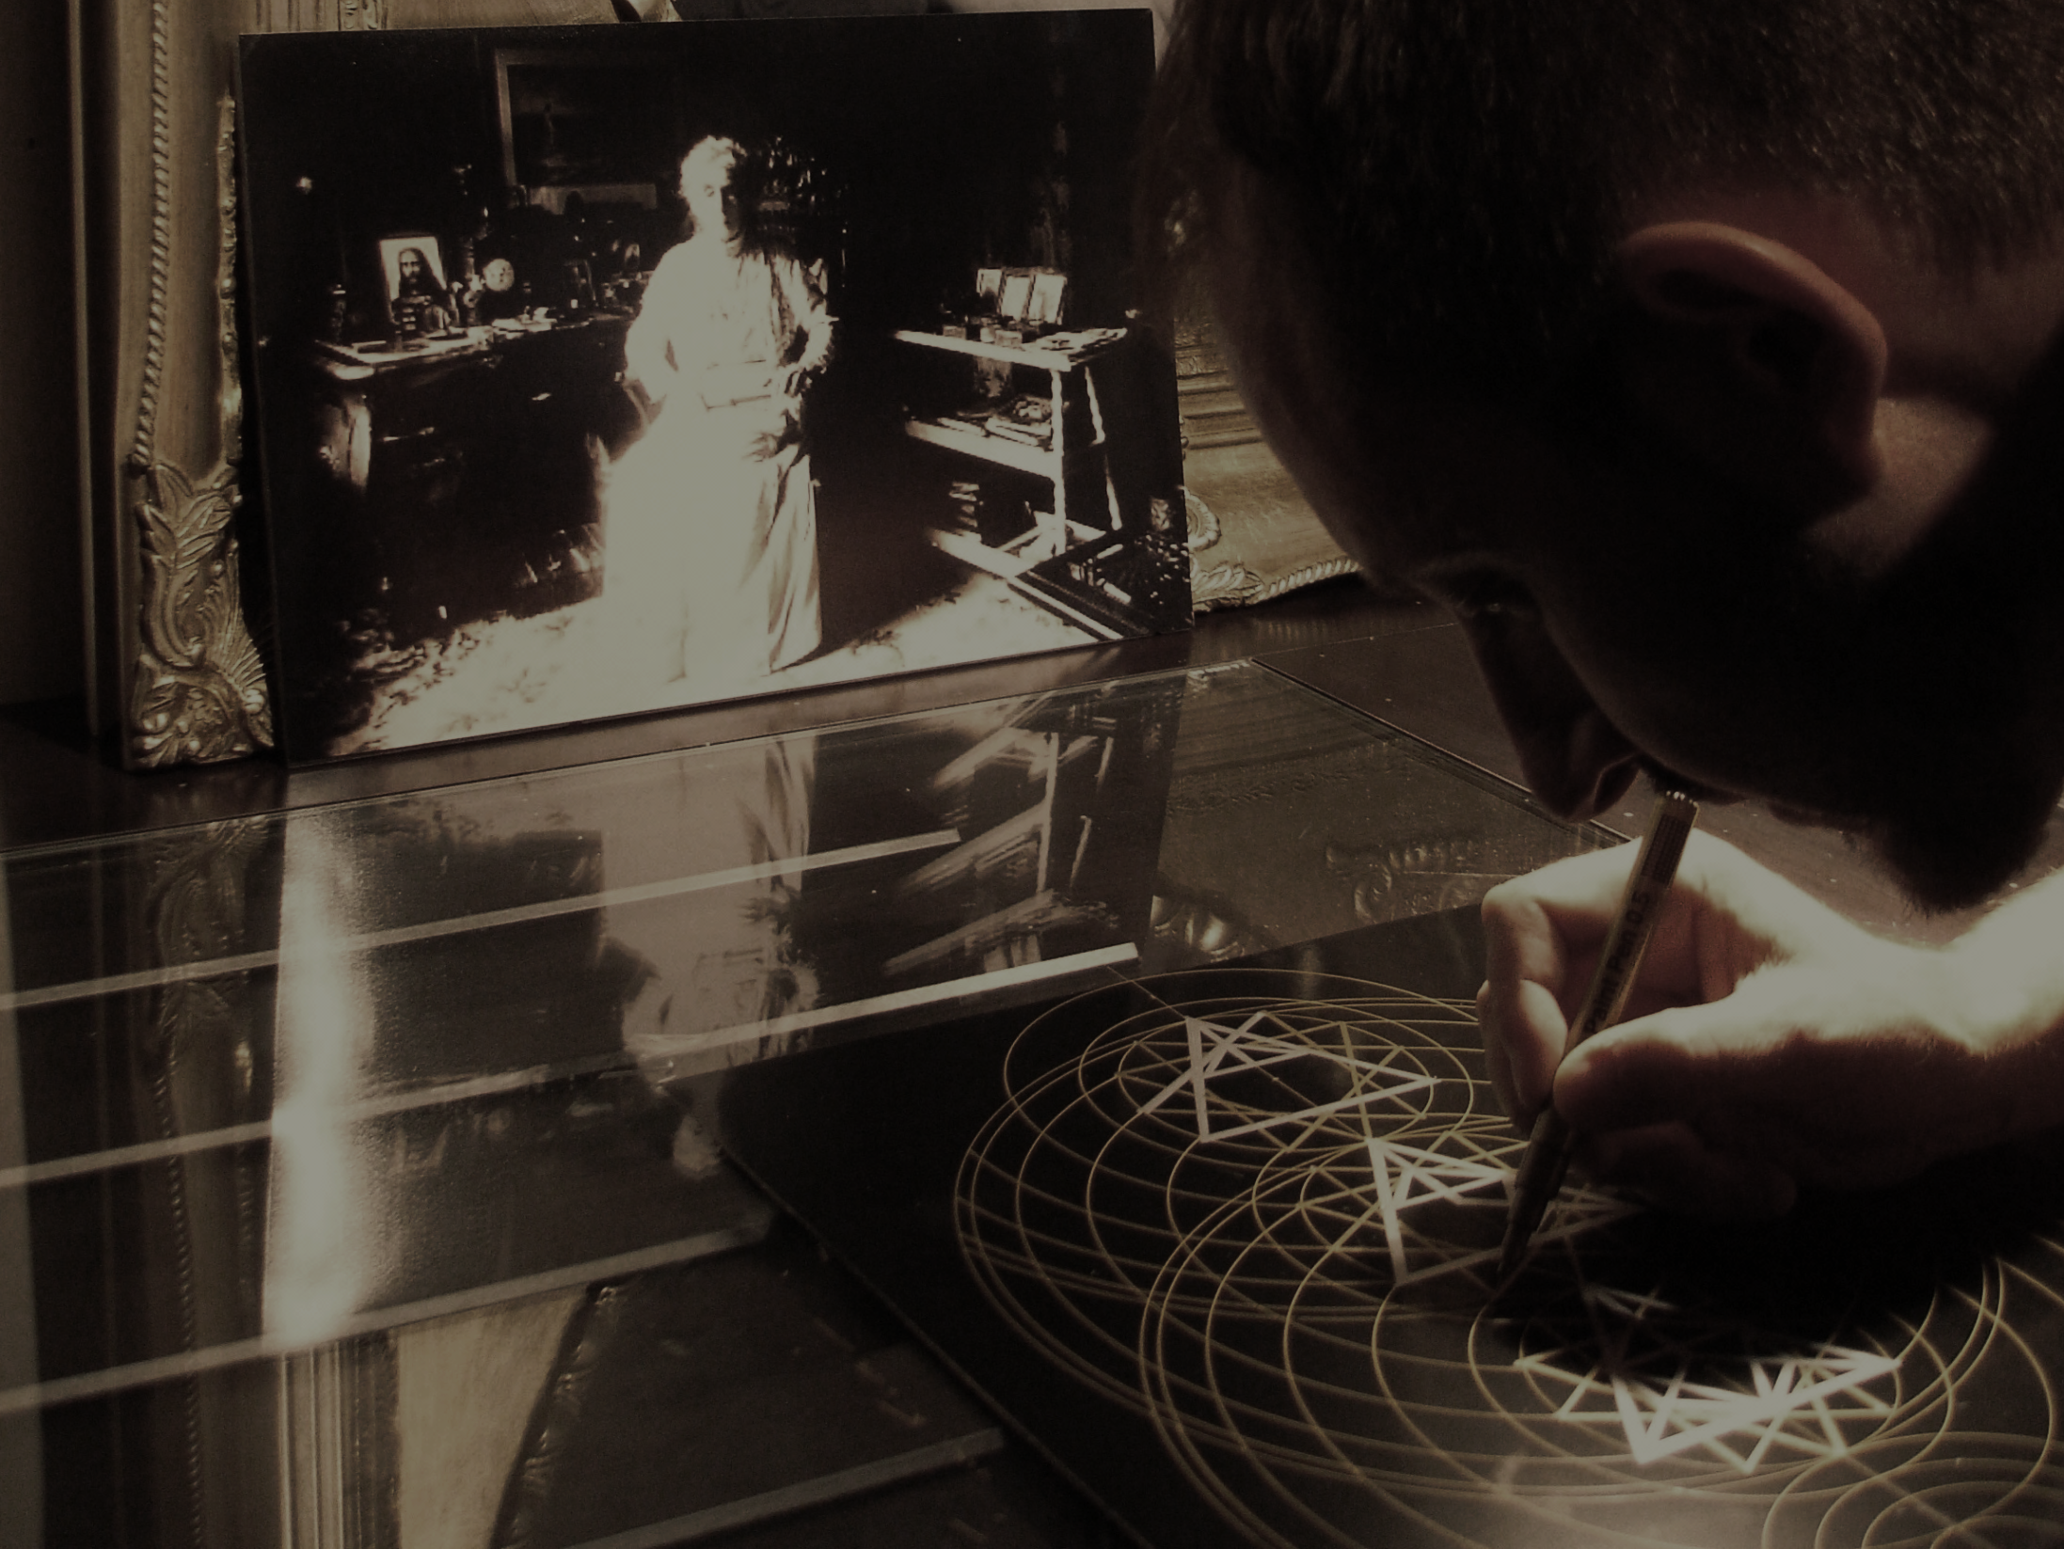
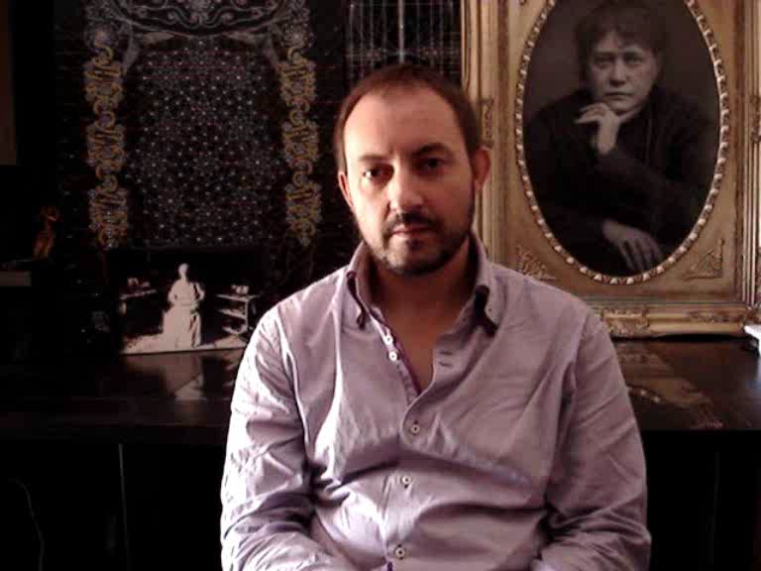
JOMA SIPE
was born in the city of Porto, Portugal, on the 2nd August 1974.
He spent almost all his childhood in the City of Vila Nova de Gaia, near Porto, where he still lives and have his how studio. He started painting ordinary motifs as landscapes and faces, using oils and acrylics with exuberant colors. Soon he realized this was not the way that he wanted to use to express his inner spiritual feelings, the desired goal that was for long time creating inside. Since very earlier, 13-15 years of age, he started feeling an inner inquietation to discover the reasons for living in this planet and trying to answer the common phrases as “Where do we came from?”, “What are we doing here?”, “To where shall we go?”…
These inner questions took him to the public library where he found ancient books in Portuguese by Blavatsky and Besant. Then he soon realize a profound and inexplicable deep inner connection with Blavatsky and her teachings. He had the opportunity to read “Isis Unveiled”, “The Secret Doctrine”, “The Voice Of Silence”, among other texts by HPB. Searching among other books he learned about the inner system of Chakras, Occult Anatomy, Sacred Geometry, The Golden Number, several meditation and concentration techniques, the Ego, Alquimical Process, Kabalah, between many many other occult and esoteric subjects.
Joma Sipe webpage: www.jomasipe.no.sapo.pt
All images © Joma Sipe, 2012
It is forbidden to copy this images by any means. This material is protected by Copyright rights in Portugal and worldwide.
Joma Sipe‘s Video Presentation

Slide 7
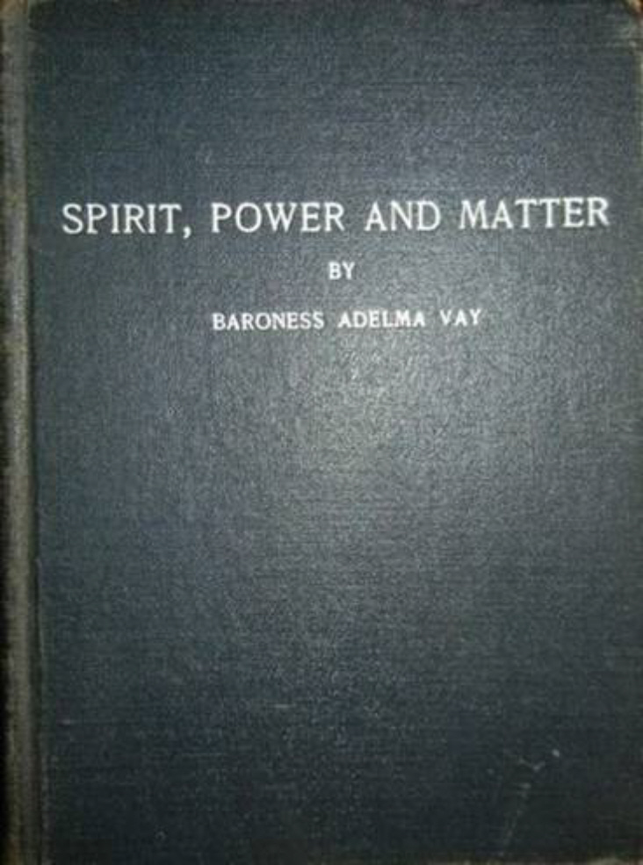
A "Szellem, Erő, Anyag" fő gondolata az, hogy elmagyarázza az Univerzum Őseredetének üzenetét.
A könyv feltárja a geometriai mintázatát a "számtörvényeknek" kizárólag matematikai alapon. Ebből adódóan fontos hogy tudjuk, a spirituális kereszténység kapcsolódik a számok geometriai erejével, és az társul az emberi lélek fejlődéséhez. A számokkal való összefüggést már Pythagoras is említette Kr. e. 500-ban.
A munka összefoglalását nagyon jól írja le a médiumi spirituális vezető Adelma, a könyve harmadik előszavában, megadva az abban használt főbb szavak definícióit, mint például vibráció, asszimiláció, ősfény és második fény, molekulák, erő, forgás, szoláris, tellúr, centrifugális/centripetális erők és a vonzás/taszítás törvényei. Ennek magyar fordítását Tóvölgyi Titusz magyarázza a következő előszóban.
Vay Adelma könyve
˝Szellem, Erő, Anyag˝
English Edition

Slide 8
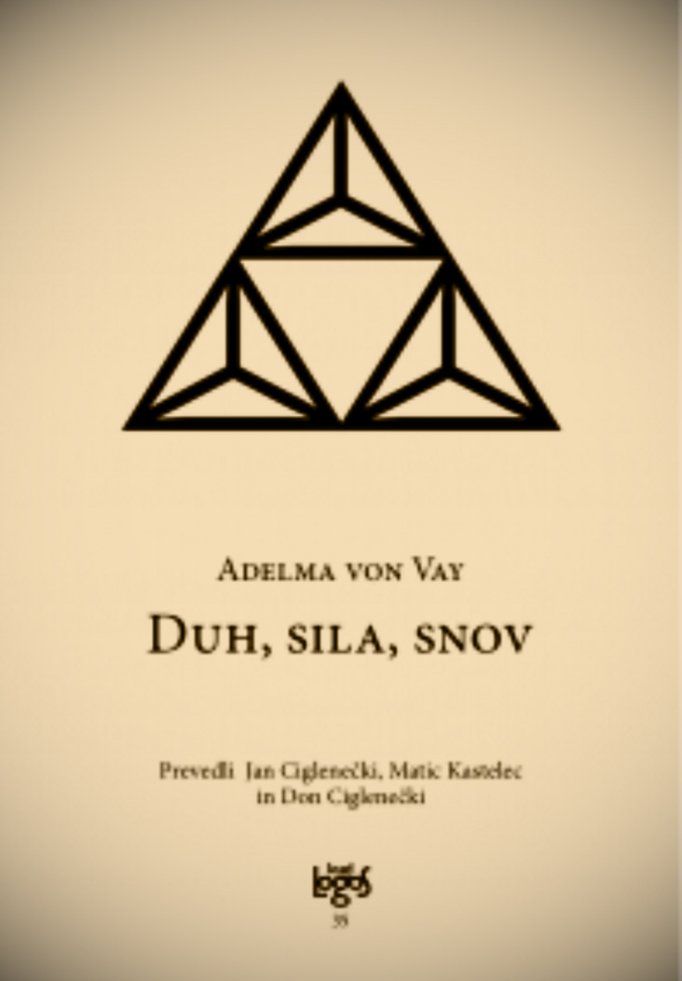
Meglátásom szerint a munka speciális kulcsszavai: VALÓSÁGOS / KONKRÉT / ABSZTRAKT, amelyek Triádot alkotnak és mindazt a számmisztikai struktúrát, amelyen a könyv alapszik. A Spirituális Vezetők által említett kulcsszavakat összekapcsolva minden folyamat nagyon világosan és szokatlan módon kerül elmagyarázásra, olyan kapcsolatot teremtve a kereszténység és a spiritualitás között, ahogyan azt még soha más könyv nem tette.
A munka egyedisége abban rejlik, hogy az összes folyamat "világi" leírása mellett numerikus képleteket is hozzáad, számokkal és számösszegekkel magyarázza a különböző mozgásokat és a teremtés szakaszait.
Véleményem szerint ezeket a számokat úgy értjük és adjuk hozzá a szöveghez, hogy mozgást adjunk a szavaknak, és nem egyszerű szavakká válnak, amelyeket az emberi elme megért, hanem olyan szavakká is, amelyeknek a leírását számokkal kell megérteni a spirituális elme számára.
Adelma von Vay‘s book
˝Spirit, Power and Matter˝
Slovenian Edition

Slide 9
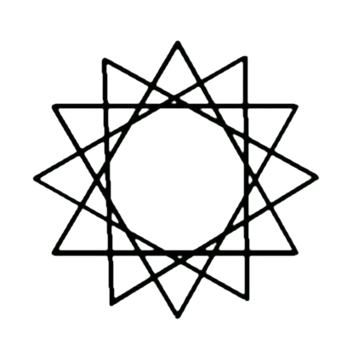
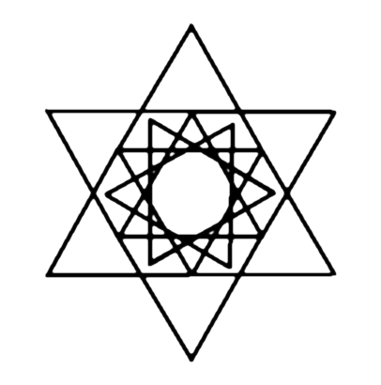
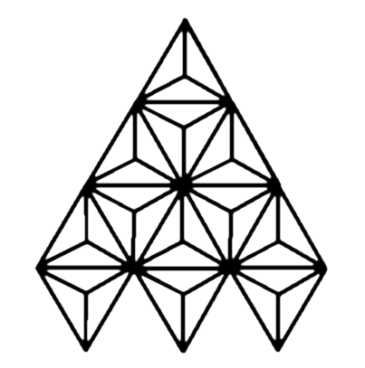
Nyilvánvaló, hogy ezek a számok olyan minták, amelyeket a spirituális elme geometriai formák létrehozásához használ. Másrészt a spirituális elme geometrikusan nyilvánul meg, létrehozva a 15 fő grafikát az A függelékben.
A Szellem Információt (Erőt) közvetít az Anyagnak.Az információ továbbításának módját Adelma három másik formában egészíti ki ebben a munkában: SZAVAK, SZÁMOK és GRAFIKA. Ez a nyelv a Lélek-Szellem: szavak az Anyaghoz, számok az Erő-mozgás-teremtéshez és grafika a Szellem-Lélek számára.
A Szellem Információt (Erőt) közvetít az Anyagnak.Az információ továbbításának módját Adelma három másik formában egészíti ki ebben a munkában: SZAVAK, SZÁMOK és GRAFIKA. Ez a Lélek-Lélek Nyelve: Szavak az anyaghoz, Számok az Erő-Mozgás-teremtéshez és Grafika a Szellem-lélek számára.

Slide 10
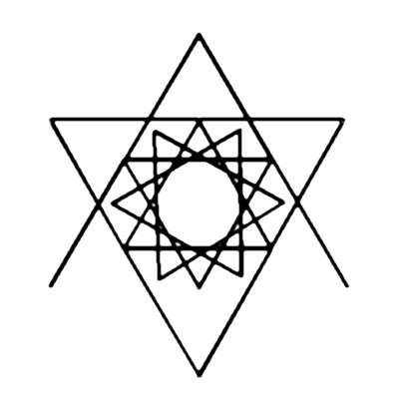
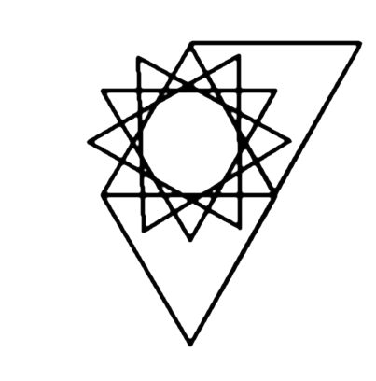
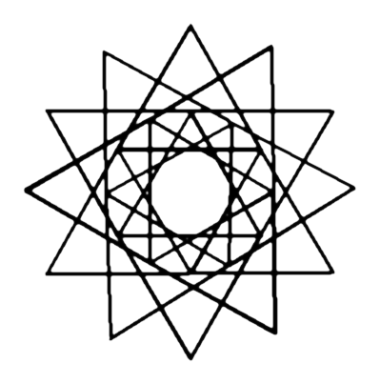
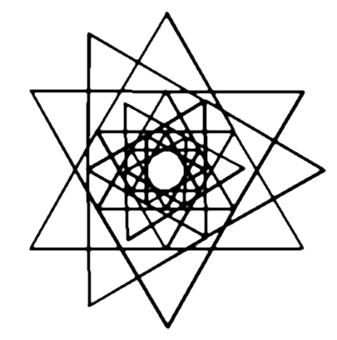
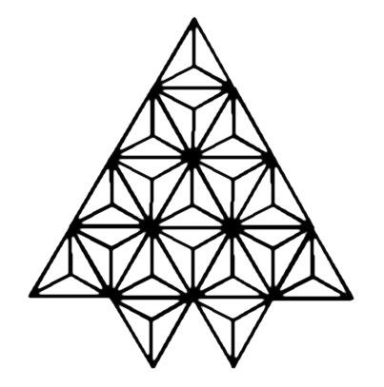
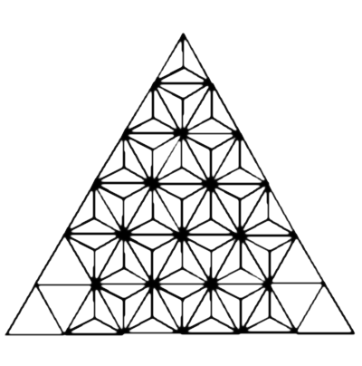
Szavak leírják a gondolatot.
A számok mozgást és rendet teremtenek.
Grafika fejezi be a folyamatot, Háromszög és Nyolcszög alapján egyszerű formákkal megállapítja, mi a Valódi, Konkrét és Sbsztrakt.

Slide 11
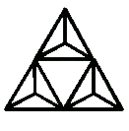
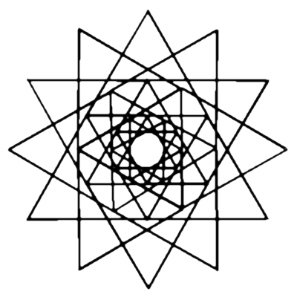
All Graphics in the Appendix A of the Book are based on a simple form, the triangle that ordains the numbers 1, 2 and 3, and describes the words Real, Concrete and Abstract.
Besides the Triangle, as a basic form, we have the Dodecagon, the 12-sided polygon that gives Movement to the intersection of triangles. I used this 12-sided Polygon in all my Graphics.
This Dodecagon has special properties and is connected with the number 3.

Slide 12
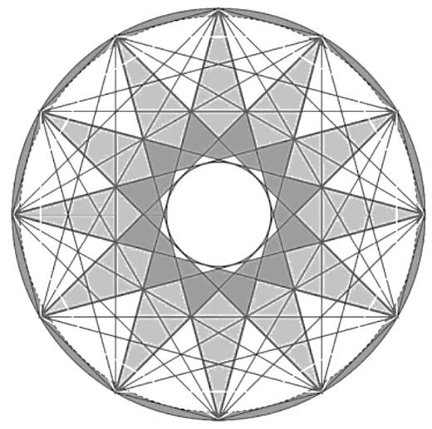
In 1991, the mathematician József Kürschák proved that dodecagon inscribed in the unit circle has area 3. He splitted dodecagon into triangles and moved one quarter of them to complete three unit squares. It is also proved that Greek, Latin, and Maltese crosses are all irregular dodecagons. The Dodecagon is perfection in a Geometrical Form. This figure comprehends 2 hexagons, 3 squares and 4 triangles.
Is the universe a dodecahedron?
The standard model of cosmology predicts that Universe is infinite and flat. However, cosmologists in France and United States are now suggesting that space could be finite and shaped like a dodecahedron instead. They claim that Universe in a shape of twelve-sided polygon can explain measurements of the cosmic microwave background – the radiation left over from the big bang – while spaces with more mundane shapes cannot. This was proposed by Jean-Pierre Luminet and colleagues in 2003 and an optimal orientation on the sky for the model was estimated in 2008.

Slide 13
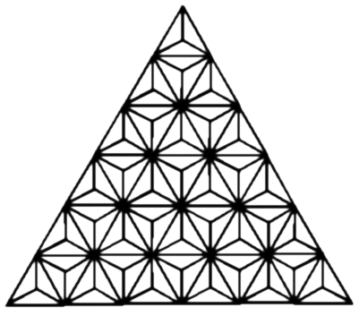
Pythagoras, 500 BC, and his followers made no distinction between music, mathematics and magic. Magic and music, for example, were found to be based upon mathematical laws. Furthermore, everything in the universe followed these mathematical laws and the universe itself was created out of geometrical relationships between numbers, and thus constituted the true basis of reality. Pythagoras believed that each number is holy and has its own powers. One, the number, was the indivisible monad, creating everything out of itself. Two, the number, was the pure duality, perfect balance between opposites. Three was the number of gods, while four was the number of the material world (hence the four elements).
In my view Graphics could be explainned as joinned, forming a triplice idea of the Universe, similar to the Christian Trinity - Father, Son and Holy Spirit - descending and ascending in Centrifugal and Centripetal Powers, repulsing and attracting each other, Fracture and the Reconciliating, creating all the 7 Grades of the Universe.
The last, 15th Graphic, completes the Cycle of Creation, originating the Sixth Solar System.

Slide 14
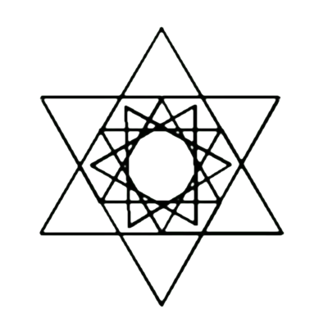
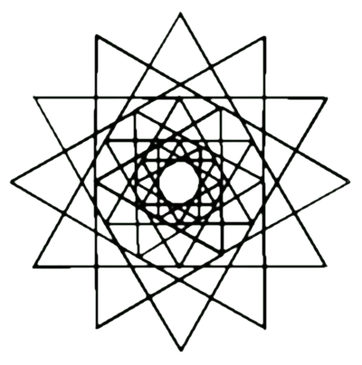
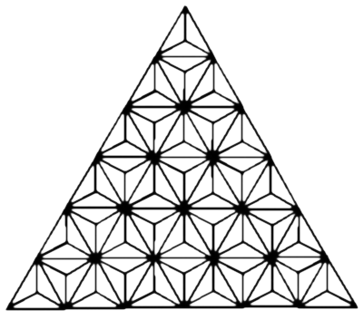
EXPOSING THE GRAPHICS
I have illustrated 15 Graphics/Charts that are mentioned in Adelma´s Book in the Appendix A. These Graphics and their names are the following:
CHART NO. 1 - Abstract 3, Primordial-light and Primordial-three
CHART NO. 2 - 1. Fracture.
CHART NO. 3 - Reconciliation.
CHART NO. 4 - New Creation, 1st Grade of the Universe
CHART NO. 5 - New Creation, 2nd Grade of the Universe
CHART NO. 6 - New Creation, 3rd Grade of the Universe
CHART NO. 7 - New Creation, 4th Grade of the Universe
CHART NO. 8 - New Creation, 5th Grade of the Universe
CHART NO. 9 - New Creation, 6th Grade of the Universe
CHART NO. 10 - Fall of the New Creation, 7th Grade of the Universe
CHART NO. 11 - Double Inclusion of the Contrast
CHART NO. 12 - Reconcilliation Further Development
CHART NO. 13 - 3. Fracture.
CHART NO. 14 - Threefold Disentanglement from the Contrast.
CHART NO. 15 - Sixth Solar System

Slide 15
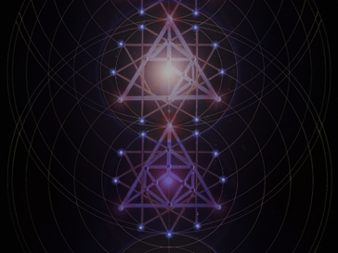
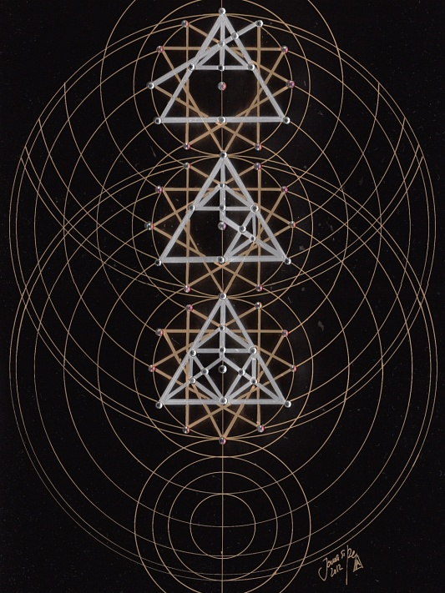
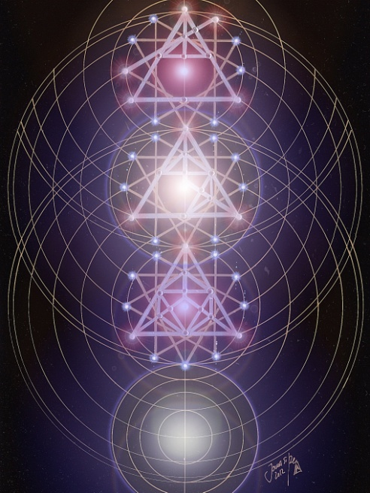
I have created two versions of Graphics, as I usually do with all my Geometrical works:
Those on the Left are the original paintings on black card, with silver, gold ink pens and crystals.
Those on the Right are the “Illuminated” Paintings, with colored Light computer effects.
The Dimension of each work is 40x30cm.
It follows an explanation, together with my Geometrical interpretation of the Charts, using Adelma´s terms - the REAL part of them. The Concrete and Abstract parts can be read in the book.

Slide 16
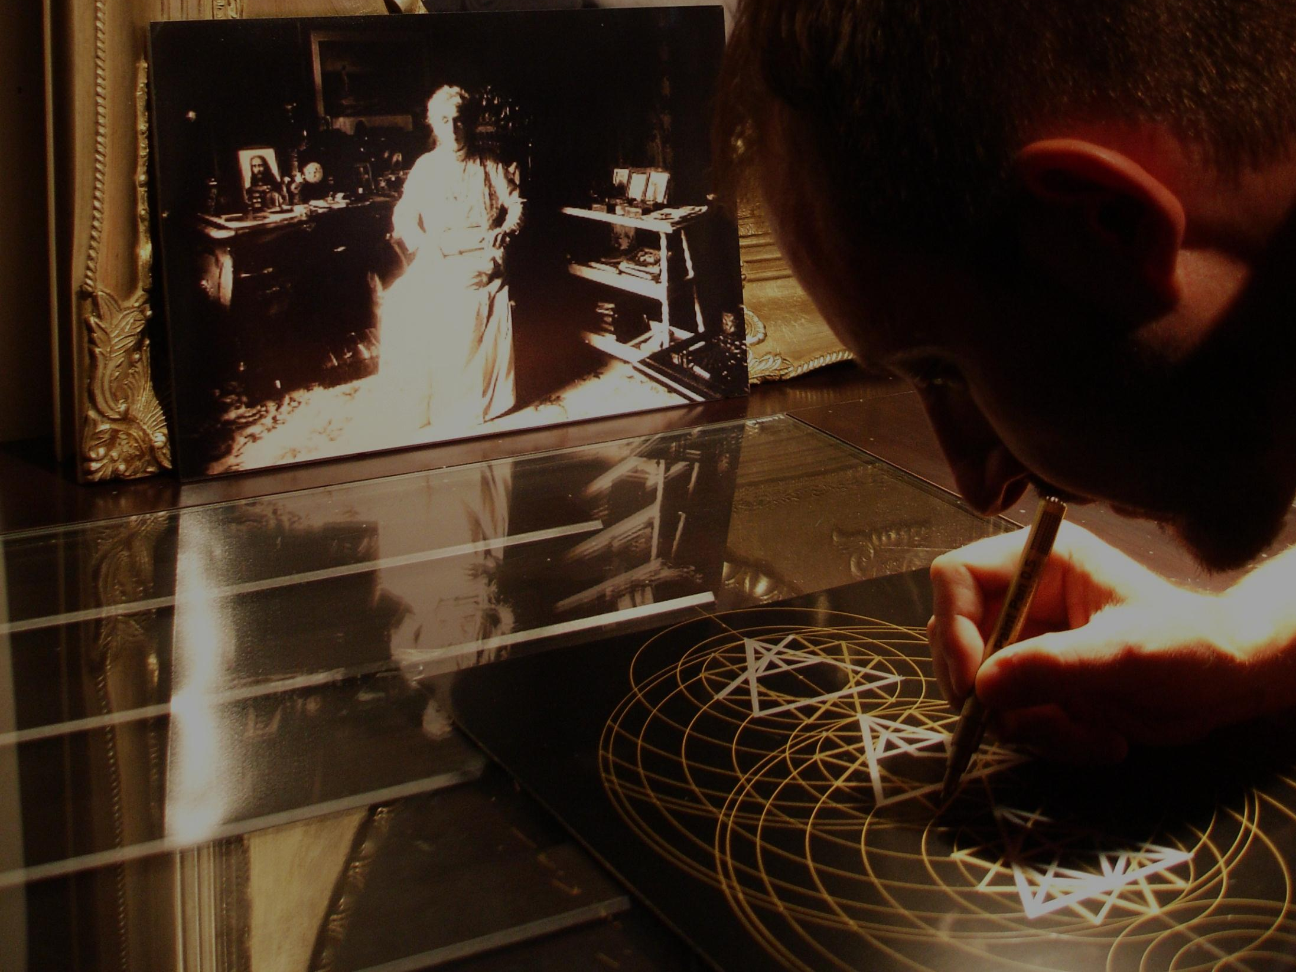
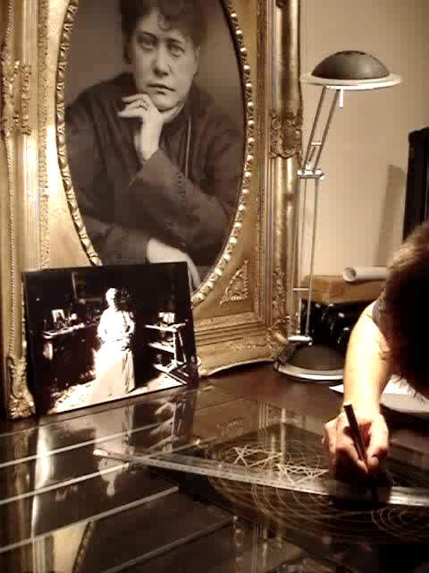
JOMA SIPE
was born in the city of Porto, Portugal, on the 2nd August 1974.
He spent almost all his childhood in the City of Vila Nova de Gaia, near Porto, where he still lives and have his how studio. He started painting ordinary motifs as landscapes and faces, using oils and acrylics with exuberant colors. Soon he realized this was not the way that he wanted to use to express his inner spiritual feelings, the desired goal that was for long time creating inside. Since very earlier, 13-15 years of age, he started feeling an inner inquietation to discover the reasons for living in this planet and trying to answer the common phrases as “Where do we came from?”, “What are we doing here?”, “To where shall we go?”…
These inner questions took him to the public library where he found ancient books in Portuguese by Blavatsky and Besant. Then he soon realize a profound and inexplicable deep inner connection with Blavatsky and her teachings. He had the opportunity to read “Isis Unveiled”, “The Secret Doctrine”, “The Voice Of Silence”, among other texts by HPB. Searching among other books he learned about the inner system of Chakras, Occult Anatomy, Sacred Geometry, The Golden Number, several meditation and concentration techniques, the Ego, Alquimical Process, Kabalah, between many many other occult and esoteric subjects.
Joma Sipe webpage: www.jomasipe.no.sapo.pt
All images © Joma Sipe, 2012
It is forbidden to copy this images by any means. This material is protected by Copyright rights in Portugal and worldwide.
Joma Sipe‘s short Video presenting his work on the Graphics

Slide 17
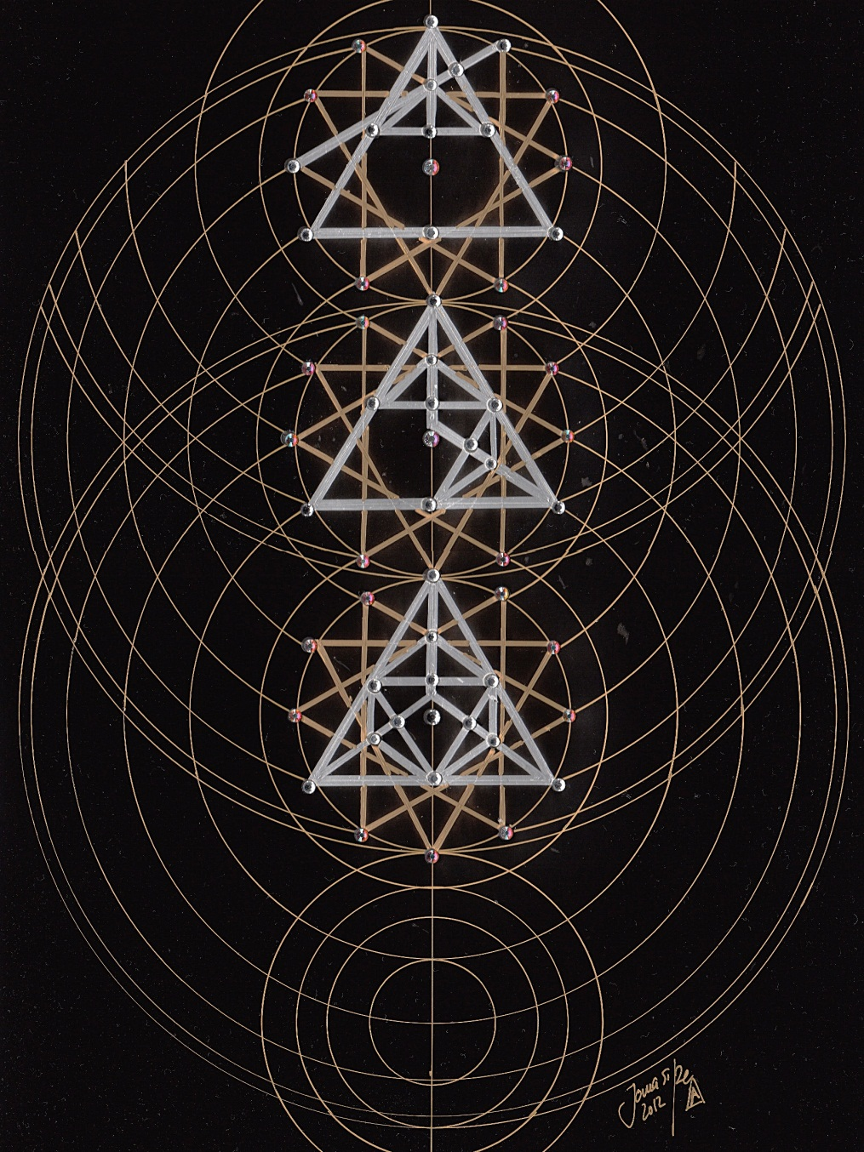

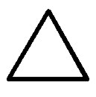

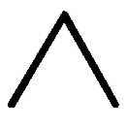
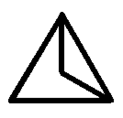
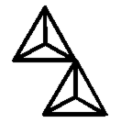


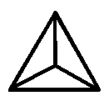
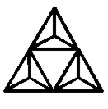
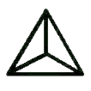
CHART NO. 1
ABSTRACT 3, PRIMORDIAL-LIGHT AND PRIMORDIAL-THREE
This Chart explains all the Words of the Work, being like a Code to decipher the Primordial Origin of the Universe. All is contained in this 3 aspects: Abstract / Primordial-light / Primordial-three.
The REAL is:
Word: God
Number: 1
Graphic:
The CONCRETE is:
Word: Spirit, Power and Primordial-light
Number: 1,2 and 3
Graphic:
The ABSTRACT is:
Word: Spirit and Love, Power and Vibration, Primordial-light and Assimilation
Number: 6
Graphic:

Slide 18
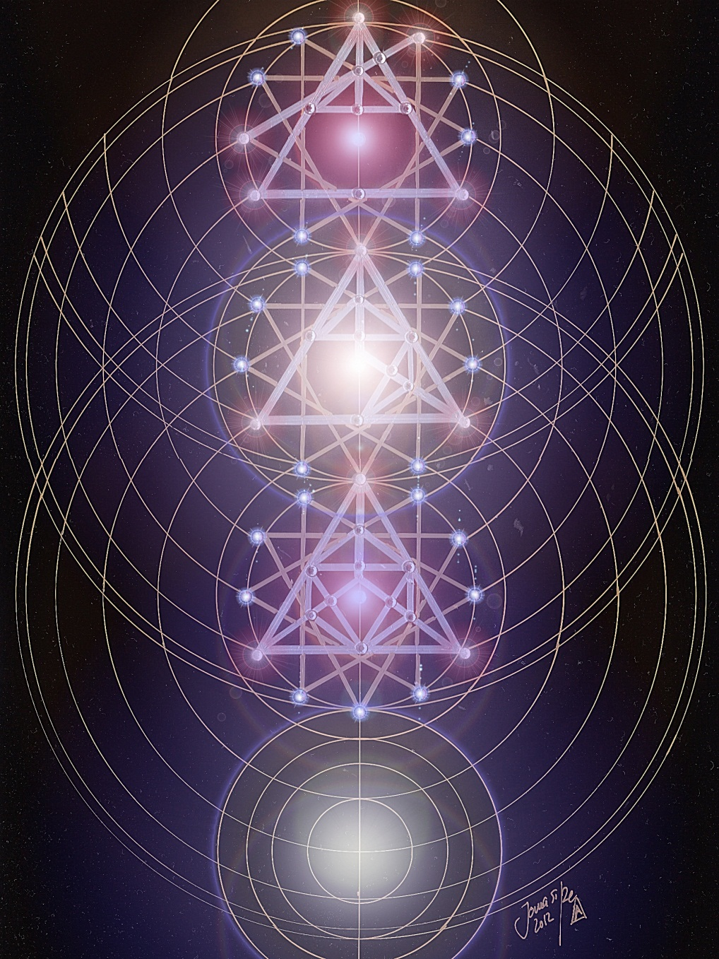

Slide 19
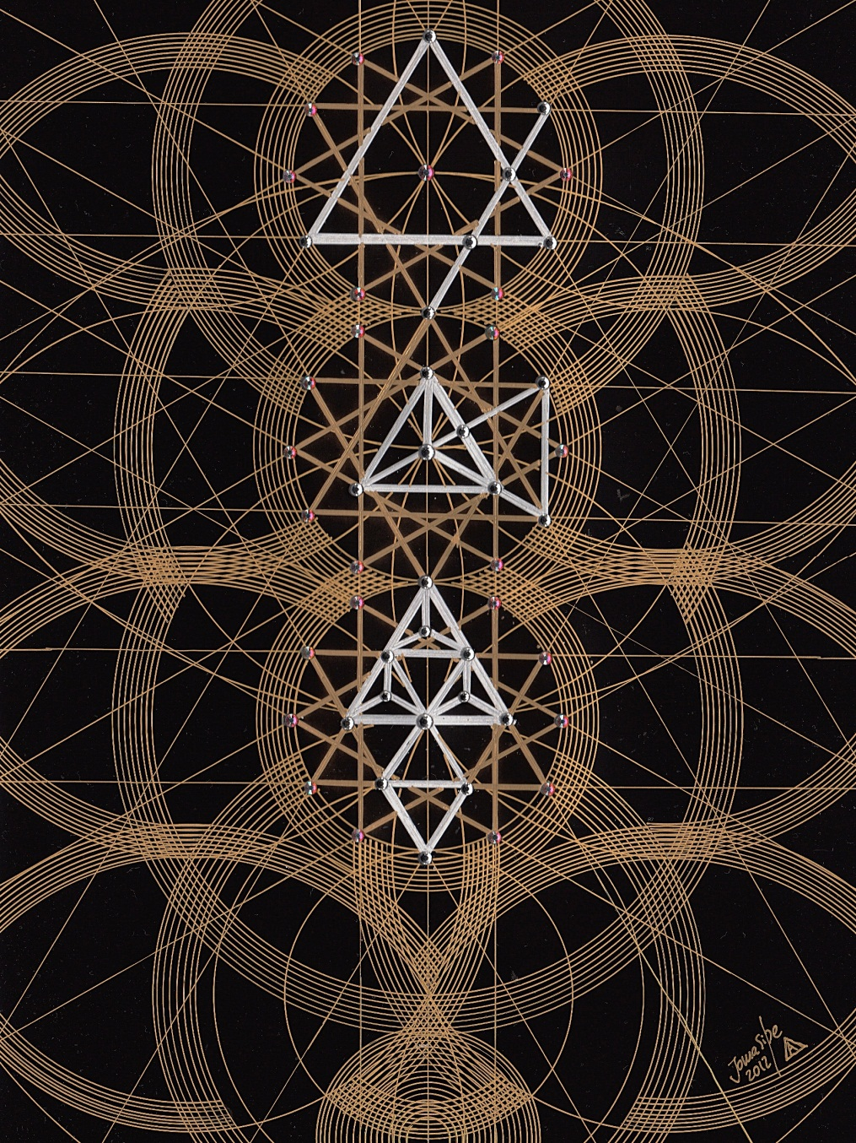
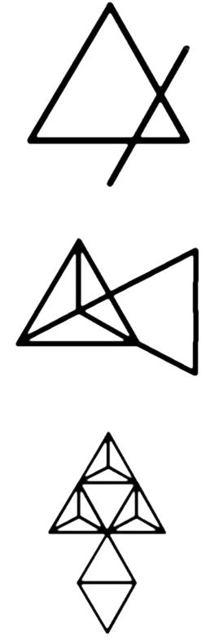
CHART NO. 2
1. FRACTURE
This Graphic is described in Chapter 4 of the book.
It tries to explain the first fracture in the Harmony that existed in the Universe.
This Fracture that breaks the triangle (the Real 3: God/Life-Principle/First-borns) produced by the First-borns who became 4 out of 3, by division of the duals.
This fracture/breaks the triangle on 2 sides (side 2 and 3).
This explains that 2 divided becomes 4, not touching the other side of the triangle (side 1), God, the Unchangeable.

Slide 20
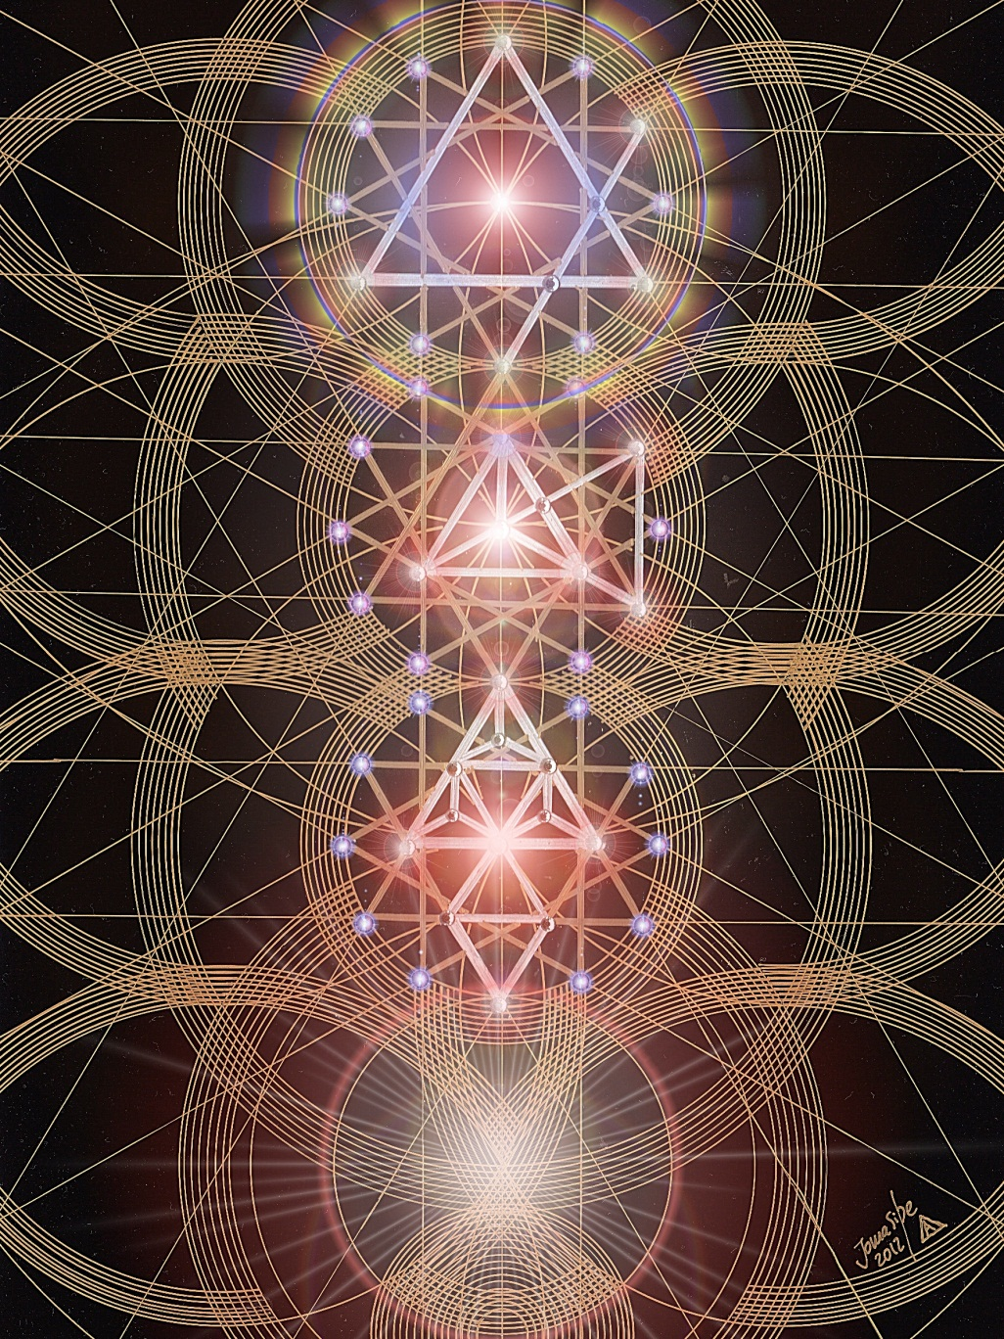

Slide 21
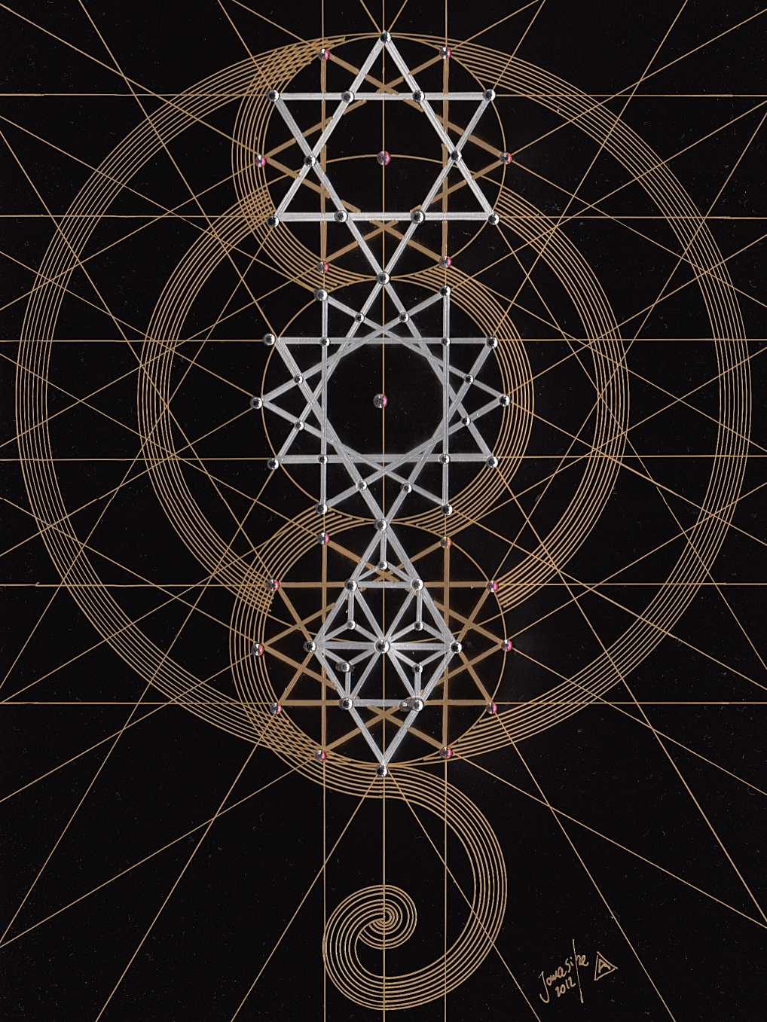
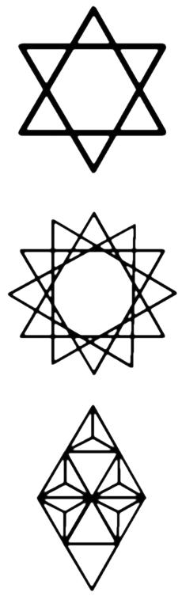
CHART NO. 3
RECONCILIATION
This Figure is mentioned as the division of 4 Fractures into 2 wholes.
This is obtained by 3, by the same number which taken as 2 was the multiplier in the Fracture.
This means that 3 is included once in 4, leaving a balance of 1, and creating in this way the double triangle.
This Graphic is the Real multiplication of 3.

Slide 22
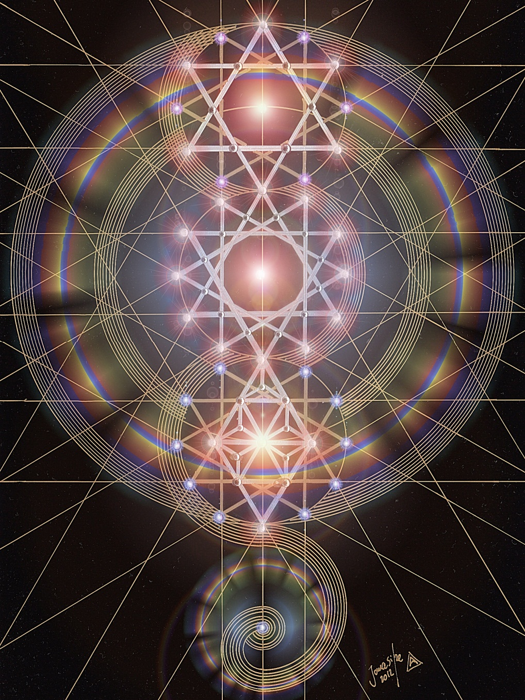

Slide 23
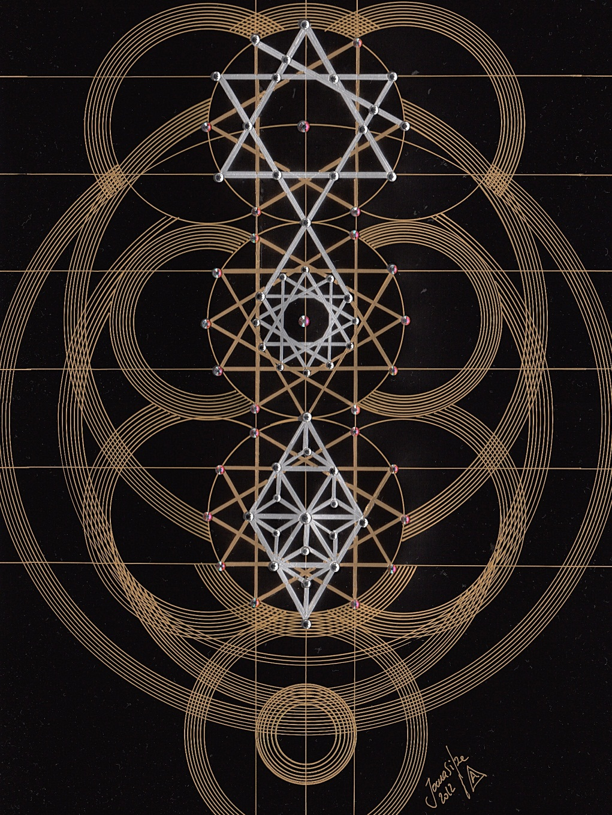
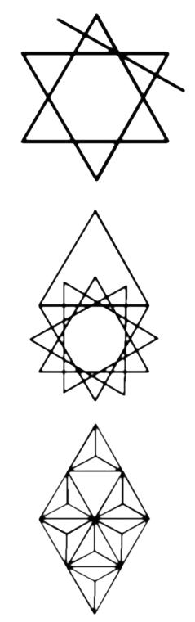
CHART NO. 4
NEW CREATION
1ST GRADE OF THE UNIVERSE
The New Creation is not a division and not a multiplication. It is a calm, lawful, undisturbed addition.
I added circles to the Chart that are mentioned by Adelma: “… the first circle in the first Real triangle.”

Slide 24
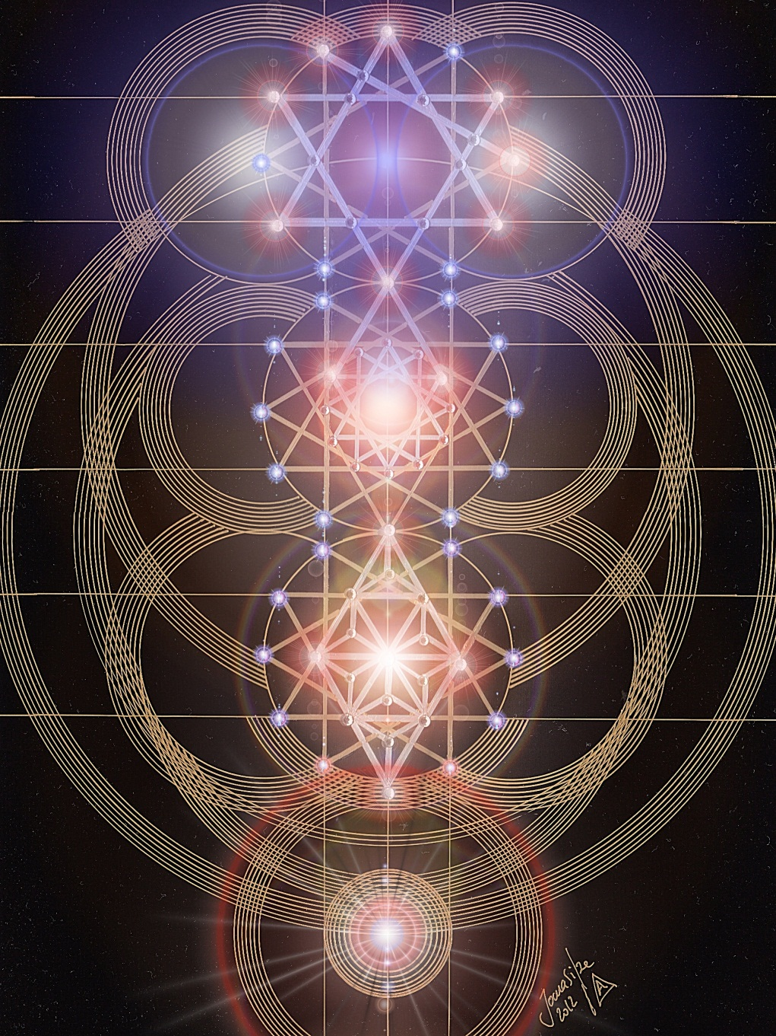

Slide 25
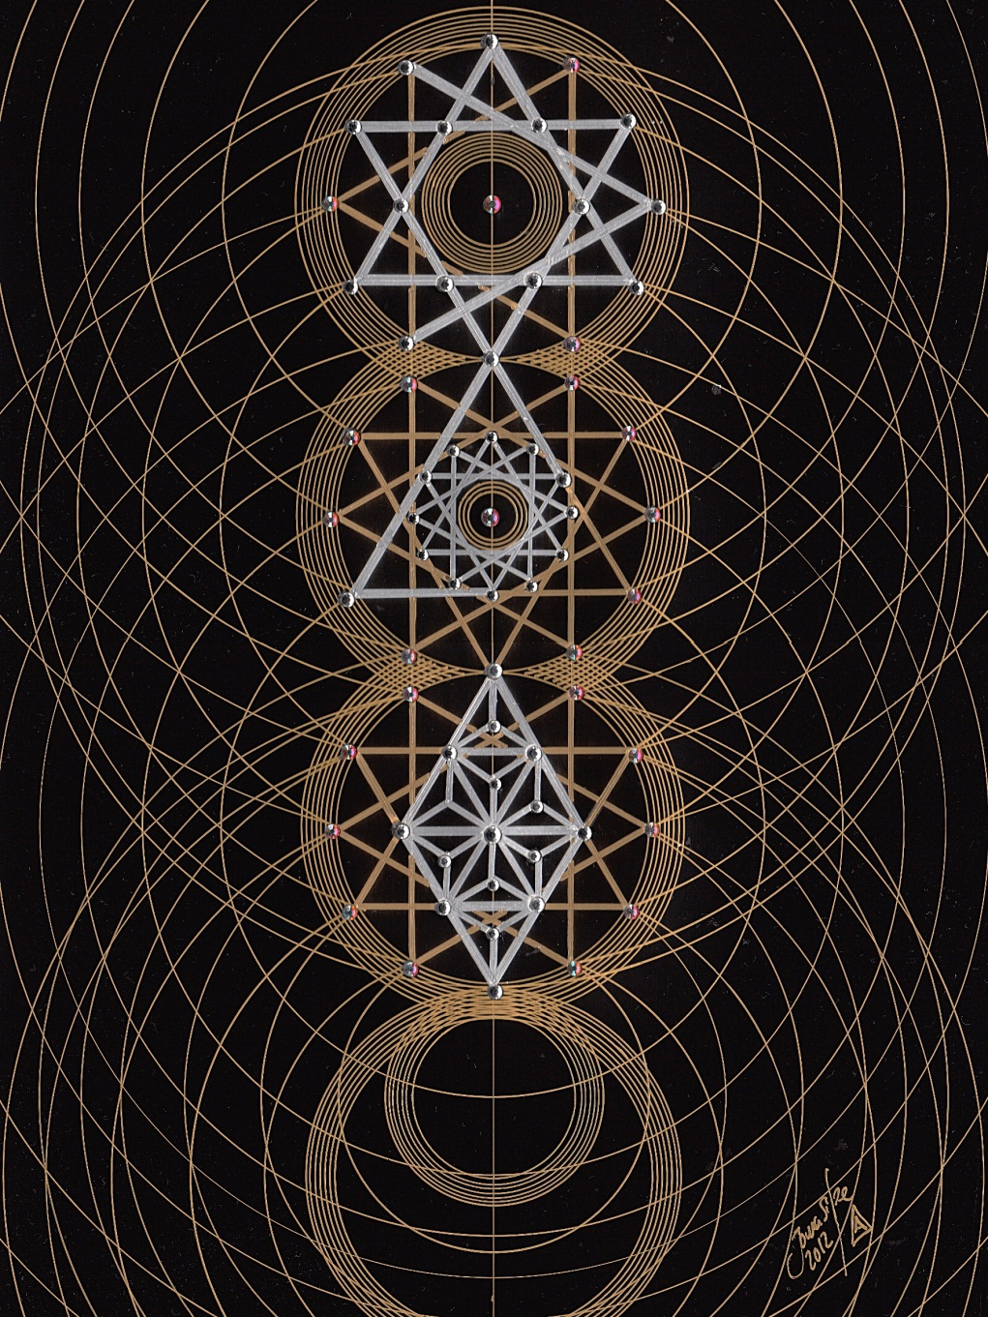
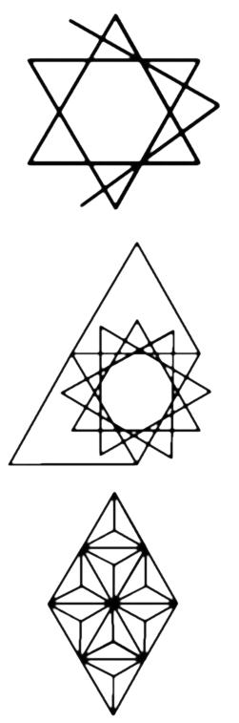
CHART NO. 5
NEW CREATION
2ND GRADE OF THE UNIVERSE
The consequences of this New Creation are Commutations.
This Chart explains the animated Universe of the Life-Principle, originating the completion of the Triangle that was originally undrawn in the last Graphic.

Slide 26
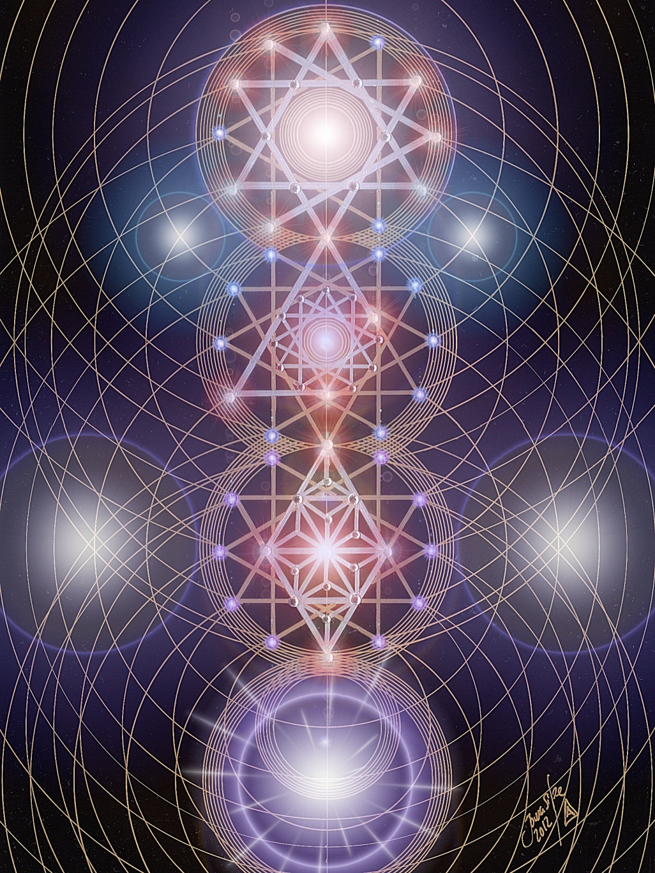

Slide 27


CHART NO. 6
NEW CREATION
3RD GRADE OF THE UNIVERSE
This Graphic illustrates the addition of everything in creation that is developed step by step, without any jump.
The consequence of this operation is a Transition.
It explains the Power of Expansion.

Slide 28


Slide 29


CHART NO. 7
NEW CREATION
4TH GRADE OF THE UNIVERSE
This Graphic shows a Comet, as Worlds moving from the embryonic state into childhood, in march towards gradual transition and change.
It describes also the Creation of Cellular-Life and Plant-Life.
It is a new Stage in Universe Development, and the mention of Cellular and Plant Lives.

Slide 30


Slide 31


CHART NO. 8
NEW CREATION
5TH GRADE OF THE UNIVERSE
The Comets described in Chart no. 7 have their development compared to the development of Power and fluids (Fluidic Secretion). In this Graphic there are explained the Semi-Circular Movements and the Commutations of Plants.

Slide 32


Slide 33


CHART NO. 9
NEW CREATION
6TH GRADE OF THE UNIVERSE
In this Chart there are finished figures, since the worlds had now left their childhood and were in their fullest development.
This development of the world is continuing calmly.
It is a series of Geometrical Figures that shows Simple Rotation and the formation of Bark, the melting of Crystals and Carbonization.
This Graphic is used by Adelma to illustrate 2 chapters of the book.

Slide 34


Slide 35


CHART NO. 10
FALL OF THE NEW CREATION,
7TH GRADE OF THE UNIVERSE
This Graphic shows the double nature of the fall of the New Creation and explains the Second Fracture.
Several processes are described in this Graphic.
It becomes one of the most complex untill now.
Here is designed the falling of Contrast Spirits, Worlds and Rotation, and its obvious consequences.

Slide 36


Slide 37


CHART NO. 11
DOUBLE INCLUSION OF THE CONTRAST
This Chart describes the double Reconciliation after the double fraction.
Here is formed sensuality and sensual organs.
Adelma describes the existence of the “Splendid Spiritual Life” in a stage of underworlds and higher worlds.
She says that “… there is a sensual augmenting endeavor.
Between both is a crevice which should be leveled off by a reconciling link”.
This link will appear in the next Graphic (Reconciling Development).

Slide 38


Slide 39


CHART NO. 12
RECONCILLIATING
FURTHER DEVELOPMENT
This Graphic describes the development of various worlds and of the Life-principle, relating it with the Embryonic Spirits, Paradises and Underworlds.
This explains the Reconciliation Development that changed the contrary to law, forming the law of nature the demons were creating in opposition to the First Principle: God.
This Reconciliation was created by God Himself, that, as the Primordial Principle of Love, does not destroy anything.
Adelma used also this Chart to illustrate the chapter, dedicated to Embryonic Spirits.

Slide 40


Slide 41


CHART NO. 13
3. FRACTURE
Here we have a Third Fracture, that is in its size twice that of the First Fracture.
This indicates the Second individual Fracture of the Spirits.
The Key Words of this Chart are the Fall of Spirits and the Separation of the Duals, introducing the Separation of Light and the expulsion of Adam and Eve from Paradise, as an allegoric passage.

Slide 42


Slide 43


CHART NO. 14
THREEFOLD DISENTANGLEMENT FROM THE CONTRAST
The quantity of figures in this Chart have a threefold reconciling movement.
The difference here is caused by the third fraction in the larger multiplying forms: Disobedient, Sensual and Arrogant Spirits, Power and Matter in all Systems of Suns, and the formation of all the millions of worlds.
Adelma uses this Chart to illustrate a chapter in the book, dedicated to the creation of the Third, Fourth and Fifth Solar Systems.

Slide 44


Slide 45


CHART NO. 15
SIXTH SOLAR SYSTEM
This Graphic shows completed figures and gives the information that we have reached a conclusion or totality.
We have 3 stars placed in each other, describing the multiplying and subtracting movement, the depotency and the potency, and the twofold course of the Universe.
All the figures, says Adelma, shows the Creation from the center and Unification towards it.

Slide 46


Slide 47
JOMA SIPE
was born in the city of Porto, Portugal, on the 2nd August 1974.
He spent almost all his childhood in the City of Vila Nova de Gaia, near Porto, where he still lives and have his how studio. He started painting ordinary motifs as landscapes and faces, using oils and acrylics with exuberant colors. Soon he realized this was not the way that he wanted to use to express his inner spiritual feelings, the desired goal that was for long time creating inside. Since very earlier, 13-15 years of age, he started feeling an inner inquietation to discover the reasons for living in this planet and trying to answer the common phrases as “Where do we came from?”, “What are we doing here?”, “To where shall we go?”…
These inner questions took him to the public library where he found ancient books in Portuguese by Blavatsky and Besant. Then he soon realize a profound and inexplicable deep inner connection with Blavatsky and her teachings. He had the opportunity to read “Isis Unveiled”, “The Secret Doctrine”, “The Voice Of Silence”, among other texts by HPB. Searching among other books he learned about the inner system of Chakras, Occult Anatomy, Sacred Geometry, The Golden Number, several meditation and concentration techniques, the Ego, Alquimical Process, Kabalah, between many many other occult and esoteric subjects.
Joma Sipe webpage: www.jomasipe.no.sapo.pt
All images © Joma Sipe, 2012
It is forbidden to copy this images by any means. This material is protected by Copyright rights in Portugal and worldwide.
Joma Sipe
www.jomasipe.no.sapo.pt
All images of the Graphics © Joma Sipe, 2012
Both works are available also as printed posters
It is forbidden to copy this images by any means.
This material is protected by Copyright rights in Portugal and worldwide.

